Slide 2
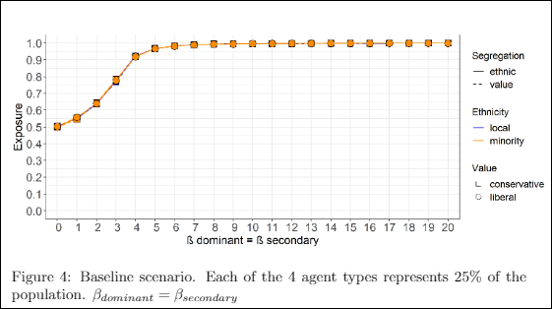
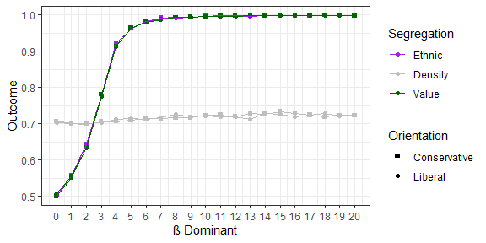
OLD 24_07
NEW 05_08
it now reports only conservatives and liberals, not taking ethnicity into account, since groups are ethnically symmetric, better visually
new on right reports also density which relates to by-product and shows difference in type of neighborhoods formed

Slide 3
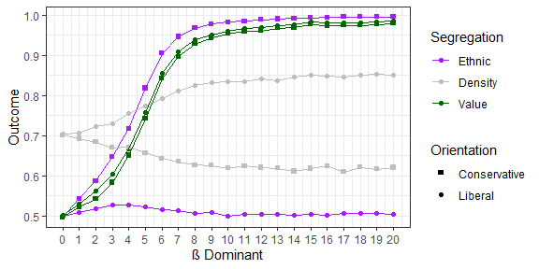
This is the condition focusing on the by-product: increase ß dominant on x-axis and ß secondary = 0
It shows now also how it relates to neighborhood density

Slide 4
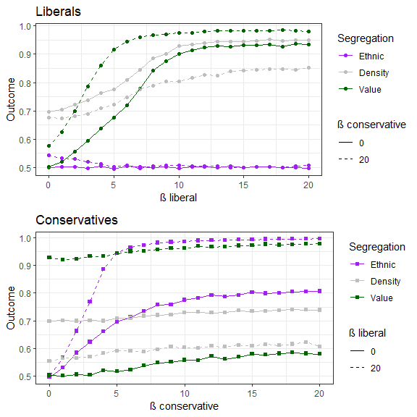
secfdom:
secfdom_secsend_lib
secfdom:
secfdom_secsend_con
specify secondary ß = 0
Old on the left: original idea was to clarify by-product value segregation of conservatives due to liberals’ preference and other mechanisms, which in the figures in previous slide might be less clear due to agents behaving together contributing to system outcome. To reach this I reported only increase of one type-group’s determinism in each panel, while the other type-group remained with both dominant and secondary ß = 0. However, this would extend the number of figures, too unrealistic (one group relocates just randomly) and for few information
New on the right: Now I report how liberals are influenced by conservatives (top panel) and vice versa for conservatives (bottom panel). x-axis: increase in determinism of group-type, linetype: how segregation patterns change if other group holds ß = 0, or maximum determinism ß = 20.
Basically with ß = 0, panel on the right includes panel on left, and compares also with max ß = 20. E.g. conservatives on the right: cleared to me if the value segregation occurs only because increase in ethnic preference on x-axis (ß value liberals = 0), or as by-product of value liberals: ß = 20, high value segregation along all x-axis.
Plus, report neighborhood density and avoided ethnic membership

Slide 5
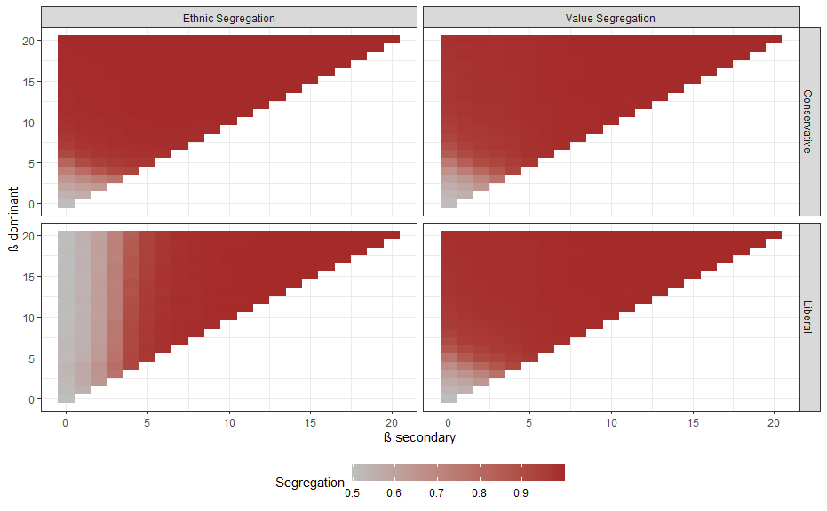
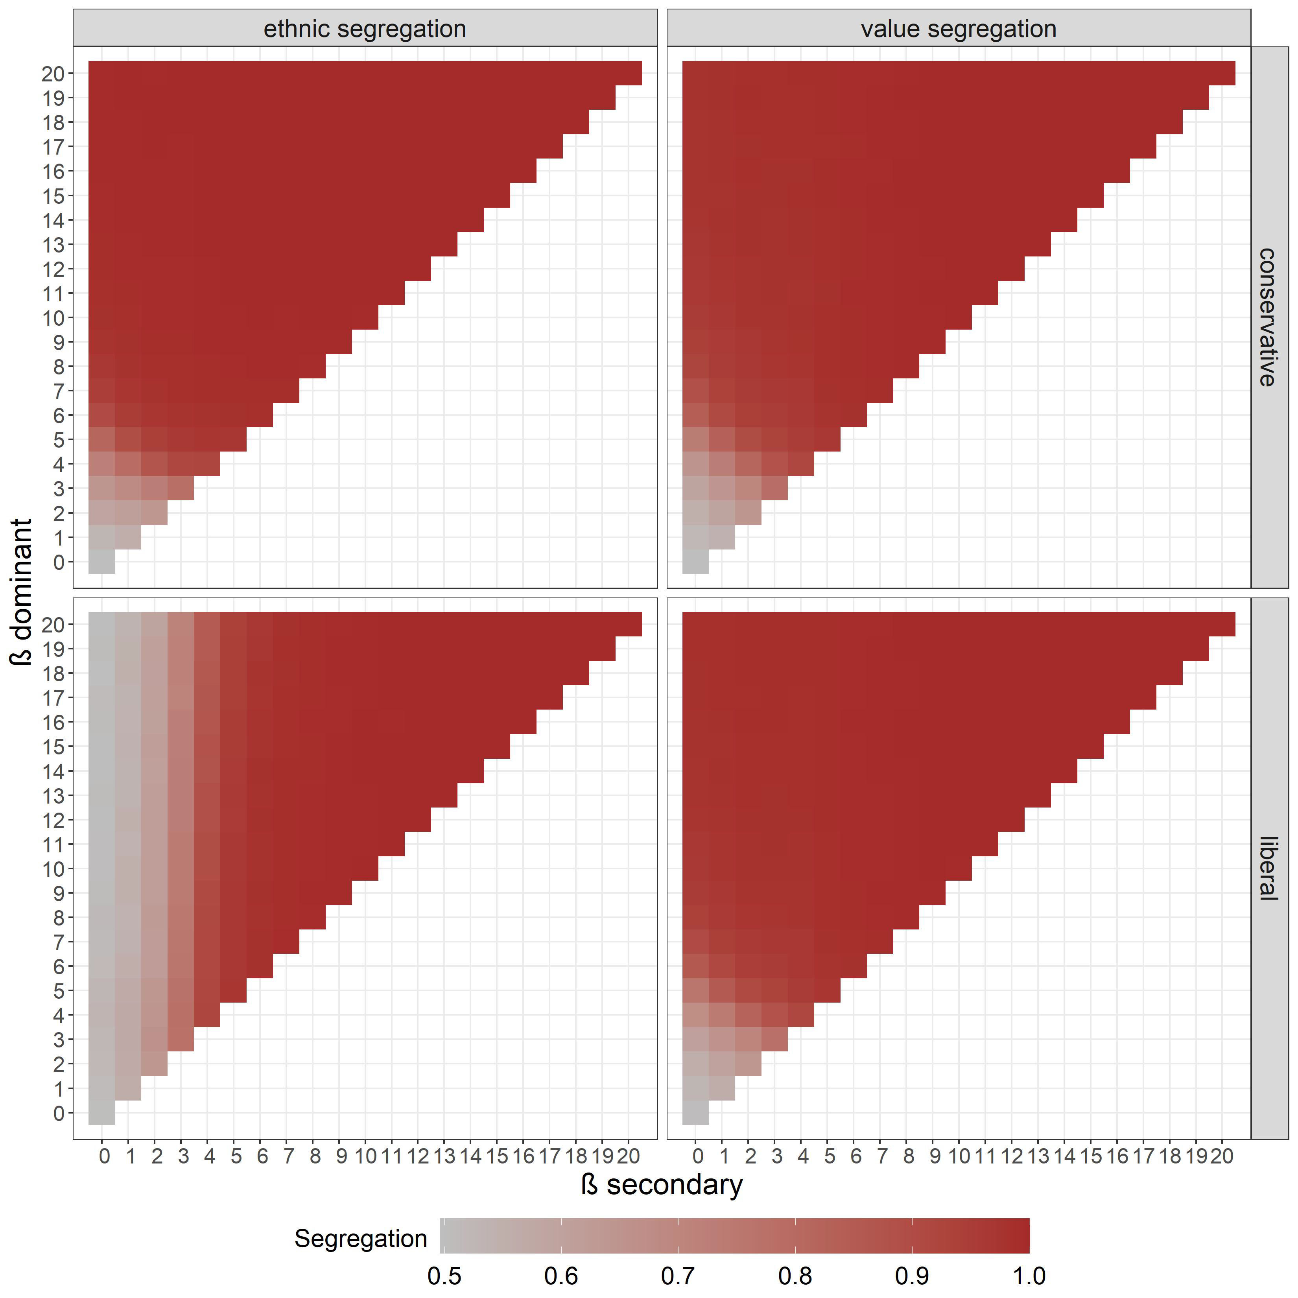
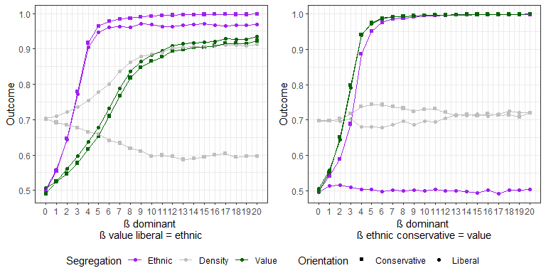
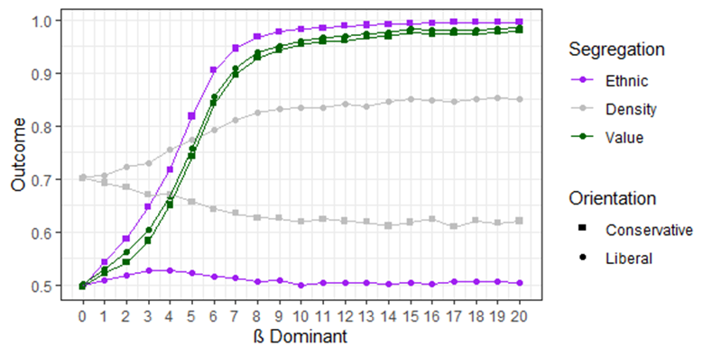
heatmap remains
old 2-panel on left: it shows increase in secondary ß on x-axis, taking the condition when all agents have max determinism ß = 20. Top panel: liberals increase ethnic preference, bottom panel: conservatives increase value preference. Due to high determinism, increase in value preference of conservatives is meaningless: they are already value segregated because of by-product. Only liberals could gradually increase ethnic segregation with increase of ethnic determinism. Basically, this choice excluded high randomness region. Also, the 2-panel fig can be derived from the heatmap: top of y-axis for each group-type and moving along the x-axis
(continues)

Slide 6
New figure on the left: the main aim is to explore also areas of lower determinism in a suitable way: all agents increase their dominant preference ß on x-axis. Left: liberals hold same ethnic preference as value preference. Right: conservatives hold same value preference as ethnic preference
This allows to compare with baseline condition and by-product figure in previous slides: how value segregation of conservatives would vary of liberals also increase ethnic preference, or effects on segregation of liberals
Also neighborhood density included
Heatmap remains to show other combinations: e.g. fix dominant preference ß = 20, and varying the secondary preference (as in the hold pic)
In heatmap agents have same degree of dominant and secondary preference.
So far to me this solution allows to explore all areas of the model to the question “if also secondary preferences are taken into account” remaining coherent with the theoretical model (e.g. a condition with liberals holding both ethnic and value ß = 20 and ß ethnic conservative = 3 is incoherent with the premises of the model)

Slide 7
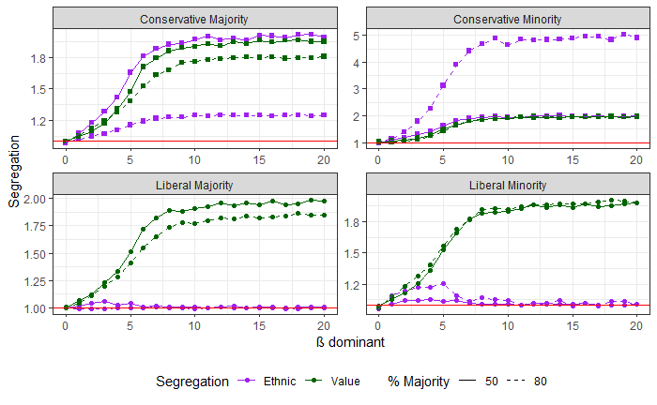
Ethnic asymmetry
Within ethnic asymmetry, the main interest is if differences occur when agents hold similar preference (degree of determinism) but are unequally represented in the population (majority/minority), and if the patterns of aggregation change given the same preference (degree determinism) compared to baseline conditions
Main scenario remains the condition with secondary ß = 0 which shows clearly by-product effect (and from here to other scenarios)
We use a corrected index for ethnic asymmetry (1 = no segregation from initial random distribution). I called originally exposure corrected, but spatial clustering might be better. My concern: to the reader might be not intuitive what is the level of local exposure of agents corresponding to spatial clustering. I tried to report both info in pics, but it is too confusing
(continue)
DIFFERENT SCALES HIGHLIGHT

Slide 8
Left panel: same condition with different indexes: on x-axis increase dominant ß (secondary ß = 0). Top panel: exposure index; bottom panel: spatial clustering. It is too confusing.
For all pics in ethnic asymmetry, I report only the spatial clustering, in the table the reader knows what local exposure is associated with spatial clustering (I tried also other aesthetics on plots, did not work)
I report the condition of 80% in figures of ethnic asymmetry. This limits to understand how ethnic ratio influences the process, but good to keep simple. Other pictures are to clarify this. Here my concern was to make clear to the reader how conditions explored in the baseline conditions section change due to direct effect of ethnic ratio:
new pic on right reports on x-axis ß dominant (secondary ß = 0), comparing 50% ethnic ratio (as in baseline) and 80% (and visually separate behavior of group-type).
Ideally the pic gives an imprint of how effects of ethnic asymmetry, exposure index and spatial clustering relate (taking into account initial distribution)

Slide 9
this pic is a special case: the original aim was to show which group-type more contributed to the baseline scenario through sensitivity analysis: keep ß dominant = 20 for all agents, in each panel varying determinism (ß) of one group-type. The red line the nominal set ß = 20
Pics show how liberals majority explains more of the final constellation and how preferences of each group-type influences the others. However, too much stuff and comes difficult to disentangle mechanisms. Now specific mechanisms are divided in different figures trying to be more concise and explain more in detail.

Slide 10
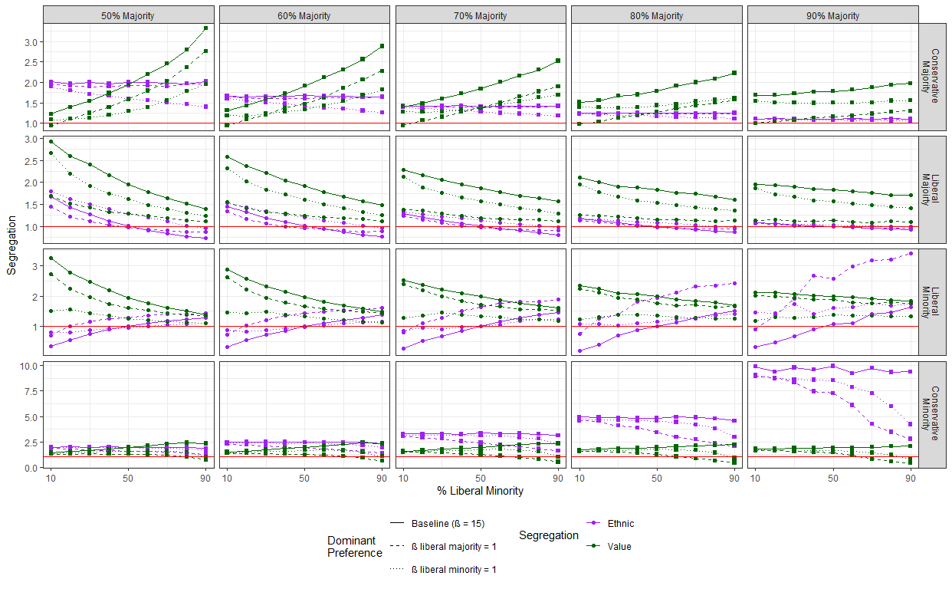
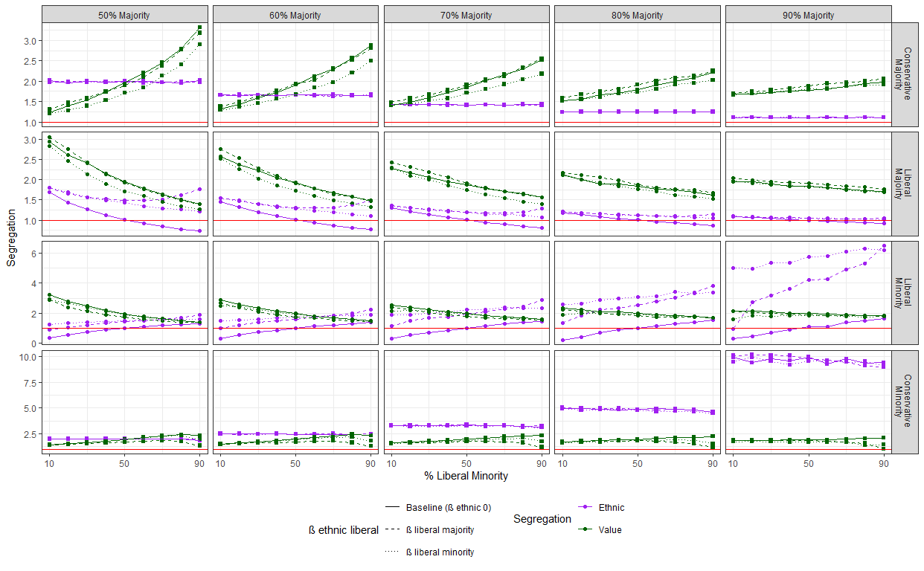
Old pic on left: originally to show the effect of distribution of liberal minority which diminishes the asymmetry between liberals majority/liberals minority. However, much text and focus for a trivial conclusions: there are more co-ethnics liberals minority can cluster with (and otherwise, more out-groups liberals majority can cluster because of value preference). Furtherly, the figure refers to 80% majority and it is limiting: to fully understand the model we need to vary both distribution of liberals and ratio of ethnic majority over ethnic minority
New pic on the right explores how mechanisms previously investigated in the 80% condition will vary if distribution of liberal minority changes as well as the ratio between ethnic groups changes
It focuses now on the outcome for each group-type and how it changes both due to preferences and population composition
It would cover further scenarios in the majority-minority paradigm and how it would interact with change in minority population

Slide 11
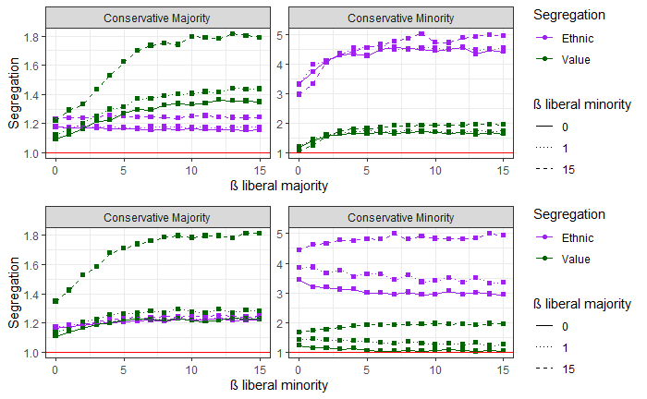
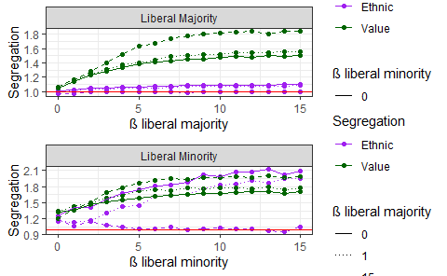
Same as previous slide: old pics on left to show the effect of value preference of liberals differing for ethnic ratio would change if the distribution of liberal minority changes (20%,50%,80%), having effect on the asymmetry between the two groups. Gross pic for little contribution
New pics on the right focus first on effect of liberals majority or liberals minority on group-type.
Each panel reports effect on one group-type, comparing how influence of liberals minority is affected by liberals majority and vice versa
The big panel shows how results would change over full combination of ethnic ratio and distribution of liberals
There is not equivalent of the heatmap in the baseline conditions for ethnic asymmetric conditions

Slide 12
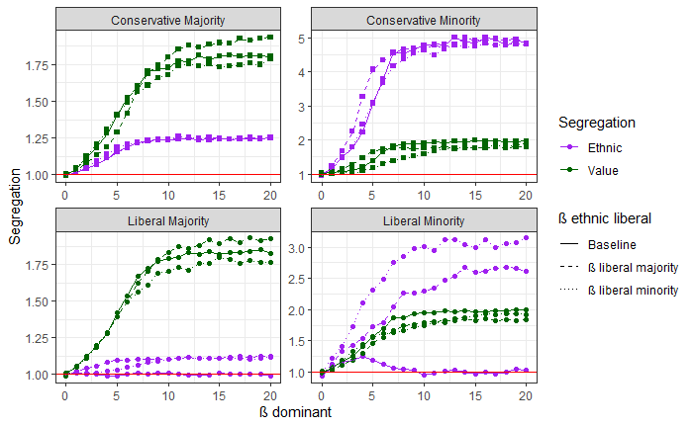
Same as previous slide. On the left: ß dominant = 20 (for liberals value), increase of ethnic preference on x-axis and how it would change due to different distribution of liberals minority. Gross pic, plus as for the baseline condition, determinism too high, causing strong segregation and limiting possible conditions to observe.
Left, 4-panel pic: liberals hold ß ethnic equal to ß value, comparing baseline condition to either increase secondary preference of liberal majority or liberal minority. The graph shows how effects might differ for different areas of determinism (on x-axis)
Full panel: how the mechanism changes due to different ethnic ratio and distribution of liberals

Slide 13
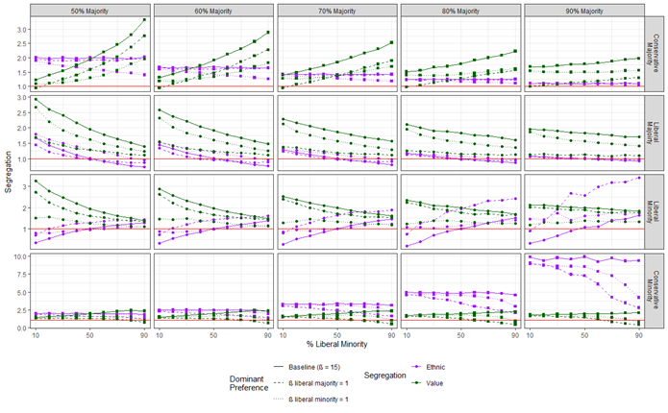
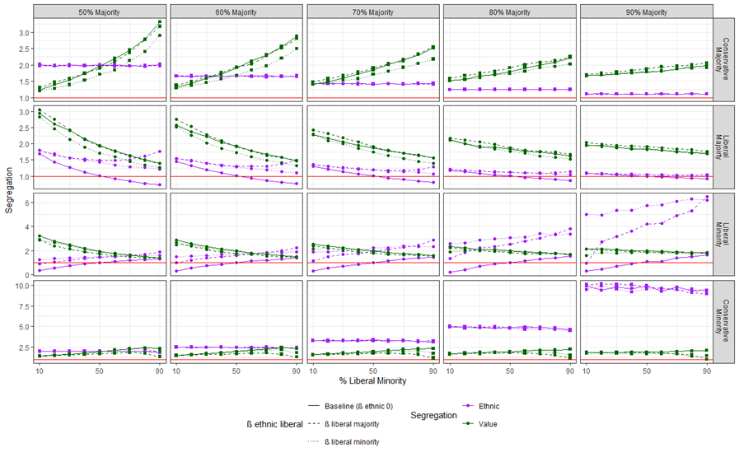
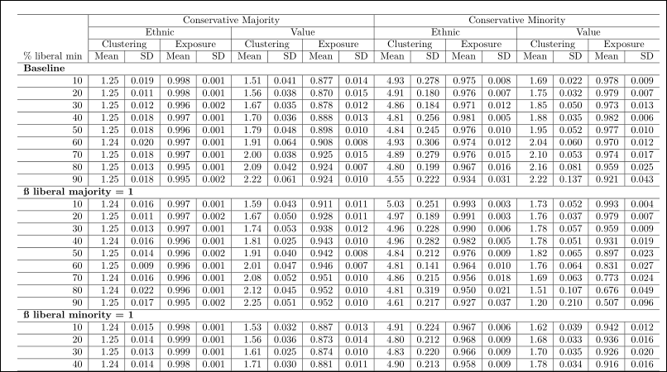
I gave up on this: the original idea was to have one single fig. showing how mechanism would be affected by ethnic ratio and distribution of liberals, and what local exposure was associated with spatial clustering emerging. Needed 3(+) Dimensions: x:ethnic ratio (% majority), y: % liberal minority, z-axis: spatial clustering, color of each condition (sphere): local exposure: red for ethnic segregation, blue for value segregation. Additionally, wanted to show how effects would differ for high determinism (ß=20, “low randomness” in bottom) and low determinism (ß=5 “high randomness” on top)
But 3D(+) dimension have down size to be highly complex to explain and difficult to position. Here is only results for conservative majority. It would require 1 page each group-type.
Now shifted to the big panels presented in previous slides: the effects are visually more intuitive, and all info is comprised in 1 page. For the match spatial clustering-local exposure, I ended up with the reader checking in the table (and mention in the description of results)
For high/low randomness: due to linear function basically you have an interpolation, I mean lower segregation for lower ß, higher segregation with higher ß, and ß was globally distributed. It was not worth it looking at final result. It makes more sense to me as now comparing the effect of liberals majority/minority lower determinism (ß = 1) to baseline with high determinism ß= 15. A 3D picture would not allow this, or at least in one pic

